Slide 1


Moving
module projects
to
Mike Schilli, Yahoo!
06/22/2009 YAPC, Pittsburgh, PA

Slide 2
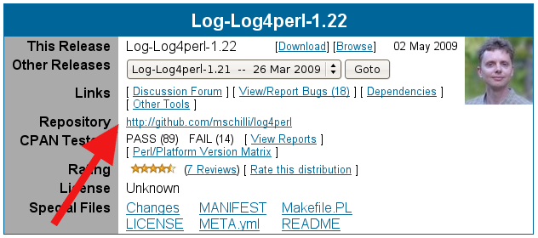
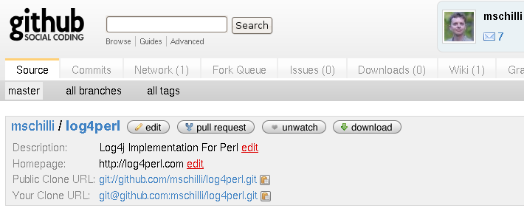
What's Github?
A source code hoster
  Like Sourceforge or Google Code
Github is not a replacement for CPAN

Slide 3
What's special about Github?
Uses git as revision control
Social coding
User-centric

Slide 4
What's special about Github?
“Follow” other people's projects/changes
Low barrier to contribute (low PITA)‏
Explosive growth of participation after projects move to Github (e.g. Rails)‏
Extremely well implemented Branching/Merging, supported by Git

Slide 5
Why Git?
So fast it makes your head spin (demo)‏
Allows for human error (reset/combine commits)‏
Entire History Local
Guaranteed to retrieve what people put in
Optimized network transfers

Slide 6

Project Development
‏

Slide 7
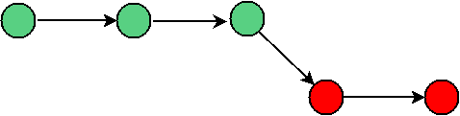
Project Development
‏

Slide 8
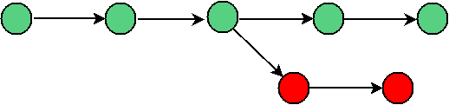
Project Development
‏

Slide 9
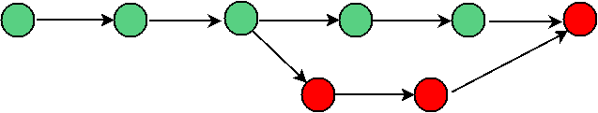
Project Development
‏

Slide 10
Project Development
‏

Slide 11
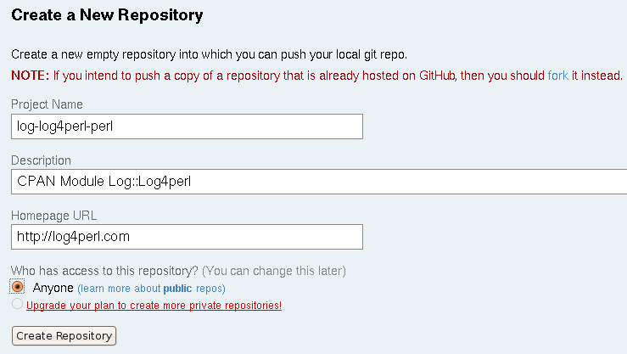
Create a new Project

Slide 12
Create a new Project
Public repos are free (300MB)‏
Private repos cost

Slide 13
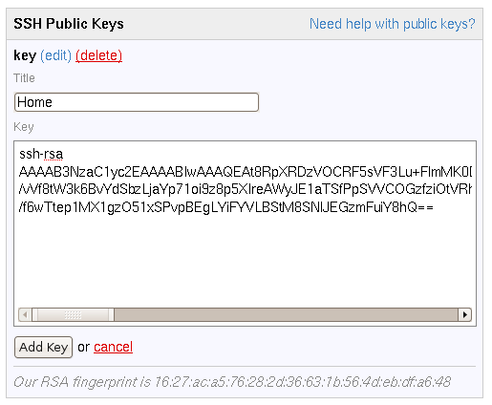
Leave your Public Key

Slide 14
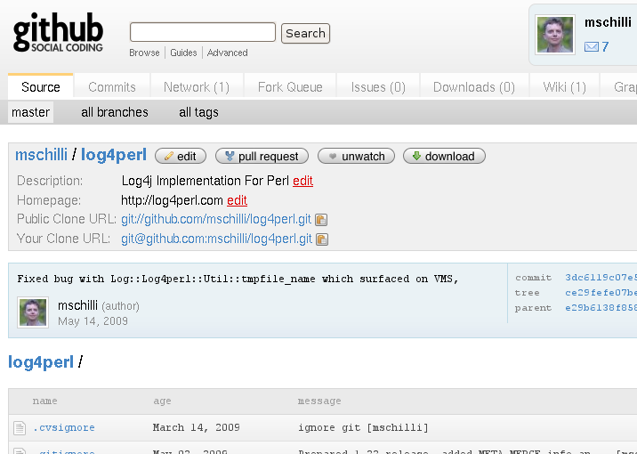
Boom, a new Project

Slide 15
Boom, a new Project
Public clone URL:
  Git clone git://github.com/mschilli/log4perl.git
Private clone URL
  Git clone git@github.com/mschilli/log4perl.git

Slide 16
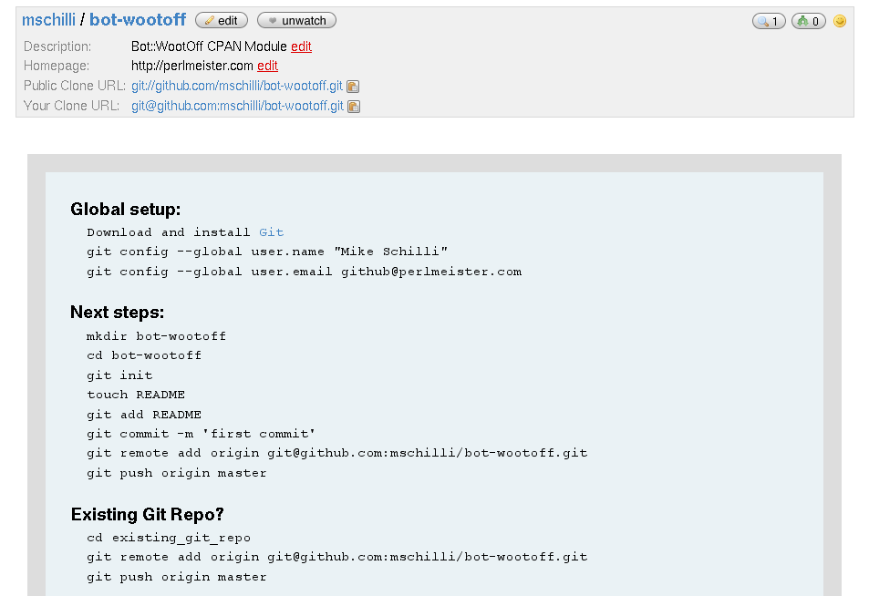
Boom, a new Project

Slide 17
A Word on Naming Conventions
http://github.com/gisle/libwww-perl
http://github.com/mschilli/log4perl
http://github.com/boumenot/p5-Net-Amazon
http://github.com/gbarr/perl-ldap

Slide 18
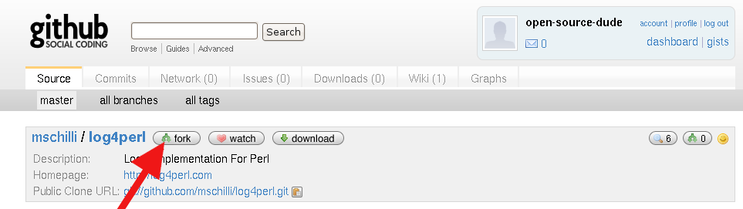
“Open-Source-Dude” finds the project
Fork to add a feature

Slide 19
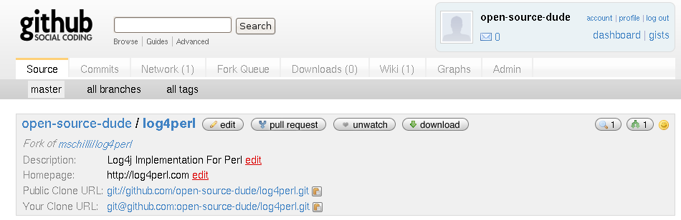
“Fork” isn't a Bad Word
Here's your new fork

Slide 20
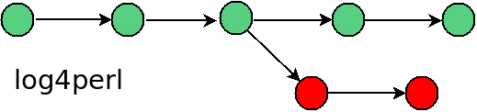
“Fork” isn't a Bad Word
‏

Slide 21
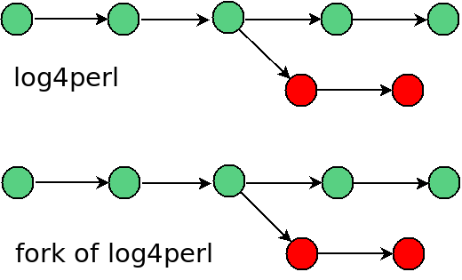
“Fork” isn't a Bad Word
‏

Slide 22
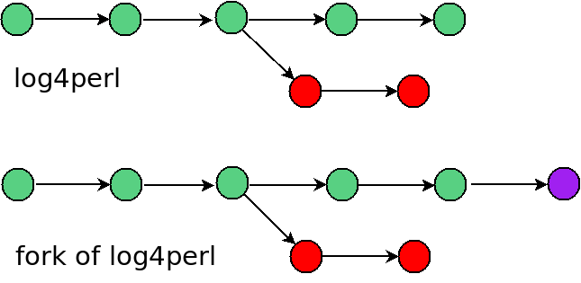
“Fork” isn't a Bad Word
‏

Slide 23
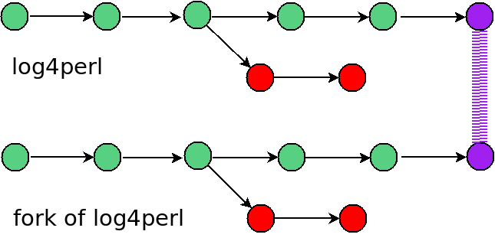
“Fork” isn't a Bad Word
‏

Slide 24
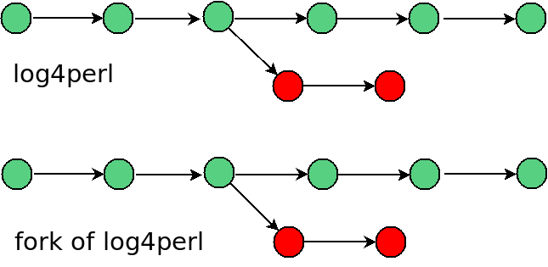
“Fork” isn't a Bad Word
‏

Slide 25
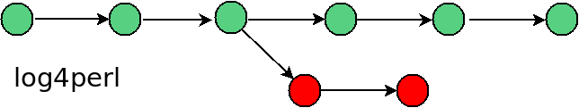
“Fork” isn't a Bad Word
“Fork” isn't a Bad Word
‏
(poof)‏

Slide 26
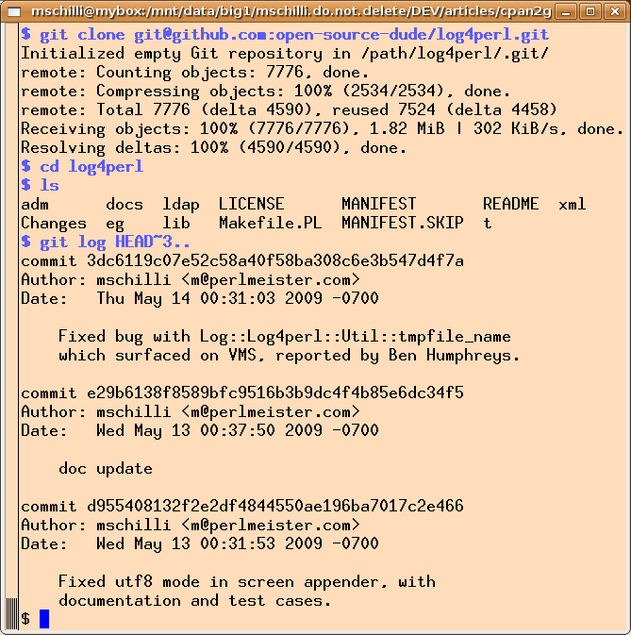
Clone your Copy

Slide 27
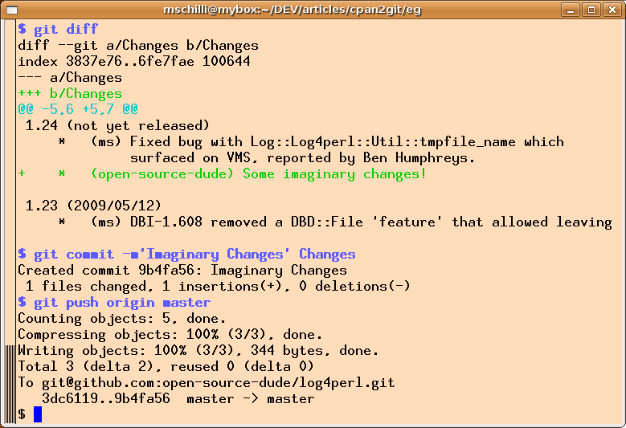
Change
Here's your new fork

Slide 28
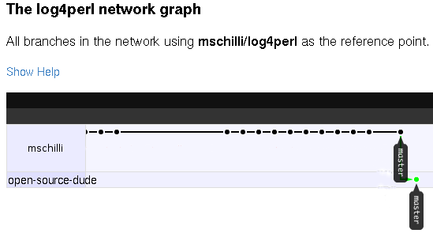
Change
Here's your new fork

Slide 29
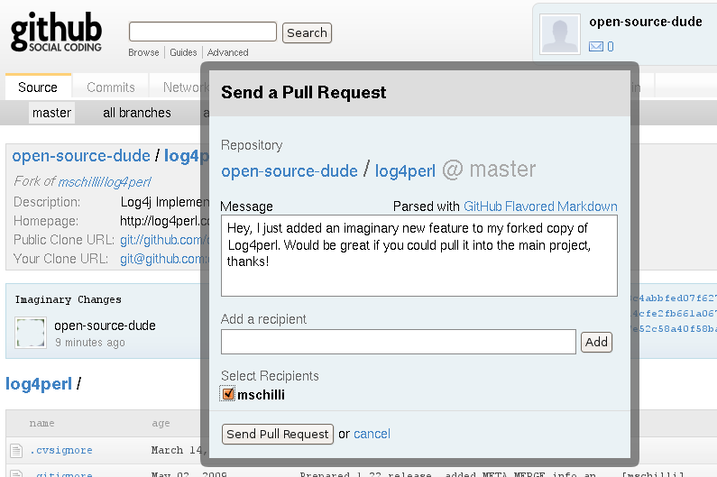
Pull

Slide 30

Receive a Pull Request

Slide 31
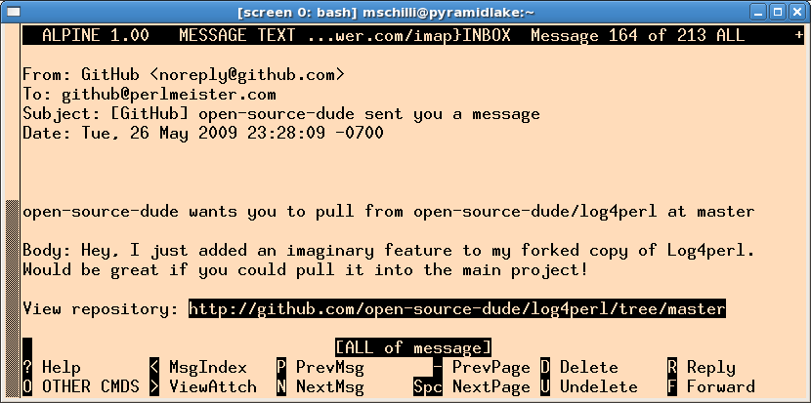
Receive a Pull Request

Slide 32
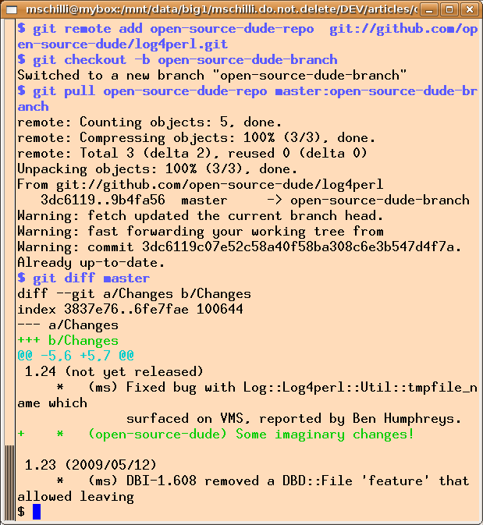
Git Pull

Slide 33
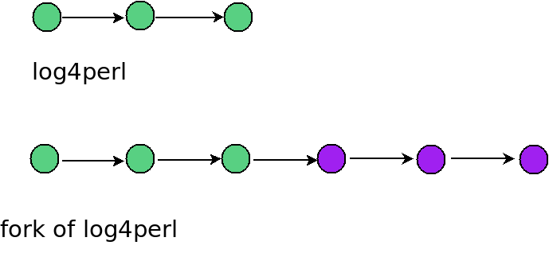
What just happened?

Slide 34
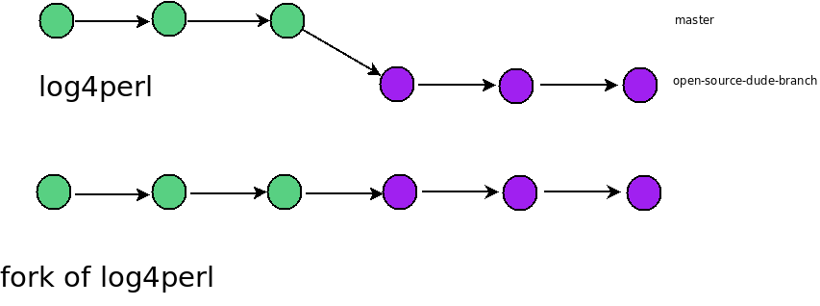
Pull changes into local branch

Slide 35
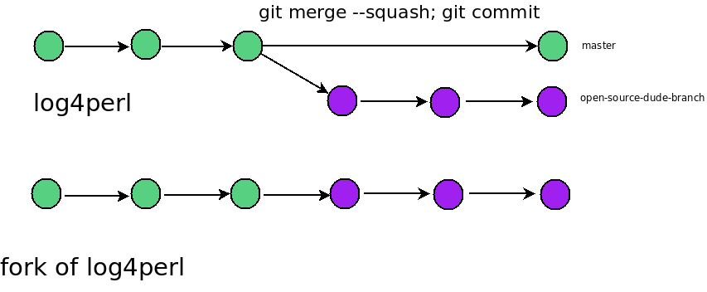
Squashed Commit

Slide 36
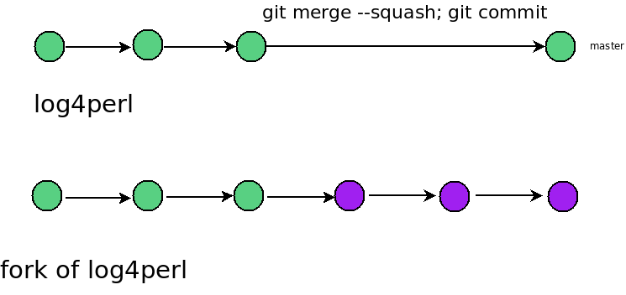
Delete Local Branch

Slide 37
Busy Projects
Ruby on Rails:
  27.3 MB
  656 forks (!)‏
Rakudo (Perl6 implementation on Parrot)‏
  9 MB
  42 forks
YUI (Yahoo Javascript lib)‏
  44 MB
  36 forks

Slide 38
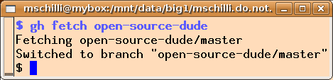
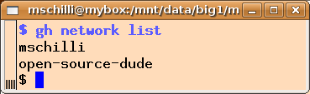
Github tools
http://gems.github.com

Slide 39
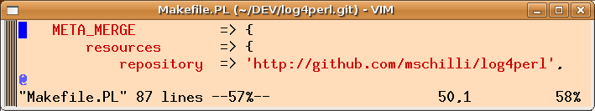
Tell the Perl community about it
Write it into the Makefile.PL ...

Slide 40
Tell the community about it
... and it shows up on CPAN

Slide 41
Push Github Releases to CPAN
How about CPAN could be triggered to fetch new releases from Github?

Slide 42
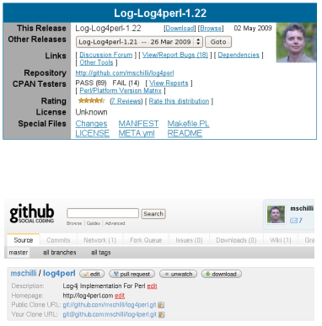
Push Github Releases to CPAN

Slide 43
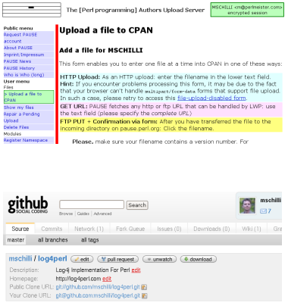
Push Github Releases to CPAN

Slide 44
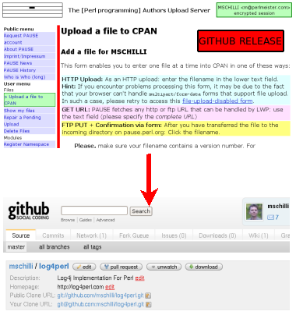
Push Github Releases to CPAN

Slide 45
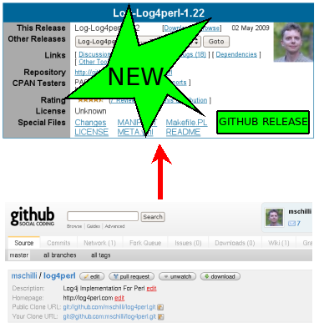
Push Github Releases to CPAN

Slide 46
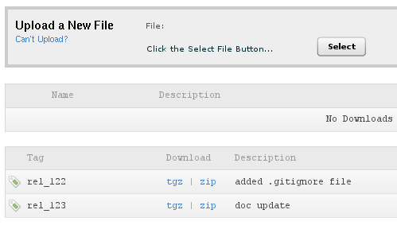
Push Github Releases to CPAN

Slide 47
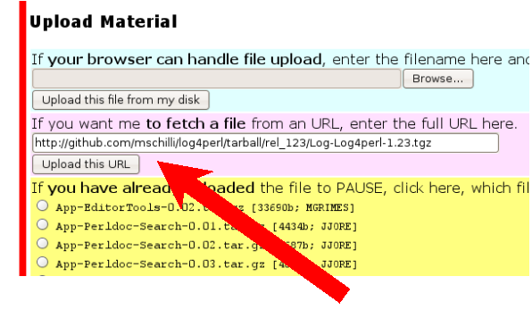
Push Github Releases to CPAN

Slide 48
References
Slides for this talk: http://perlmeister.com/talks
Github screencasts: http://www.pragprog.com/screencasts/v-scgithub/insider-guide-to-github
“Version control with git”, Jon Leoliger, O'Reilly 2009
Dan Dascalescu, "The PITA Threshold: GitHub vs. CPAN",http://wiki.dandascalescu.com/essays/pita-threshold
Turn your Sourceforge Project into a Git Repo", http://blog.usarundbrief.com/?p=12

